Slide 1
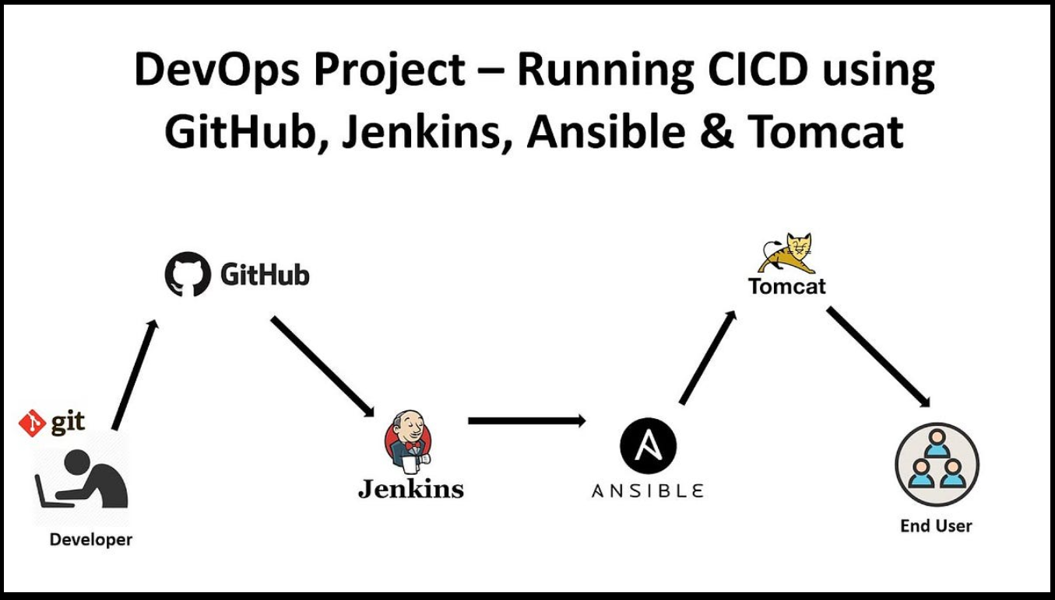
Project 3: CI/CD using Jenkins + Maven + Ansible + Tomcat Architecture Overview

Slide 2
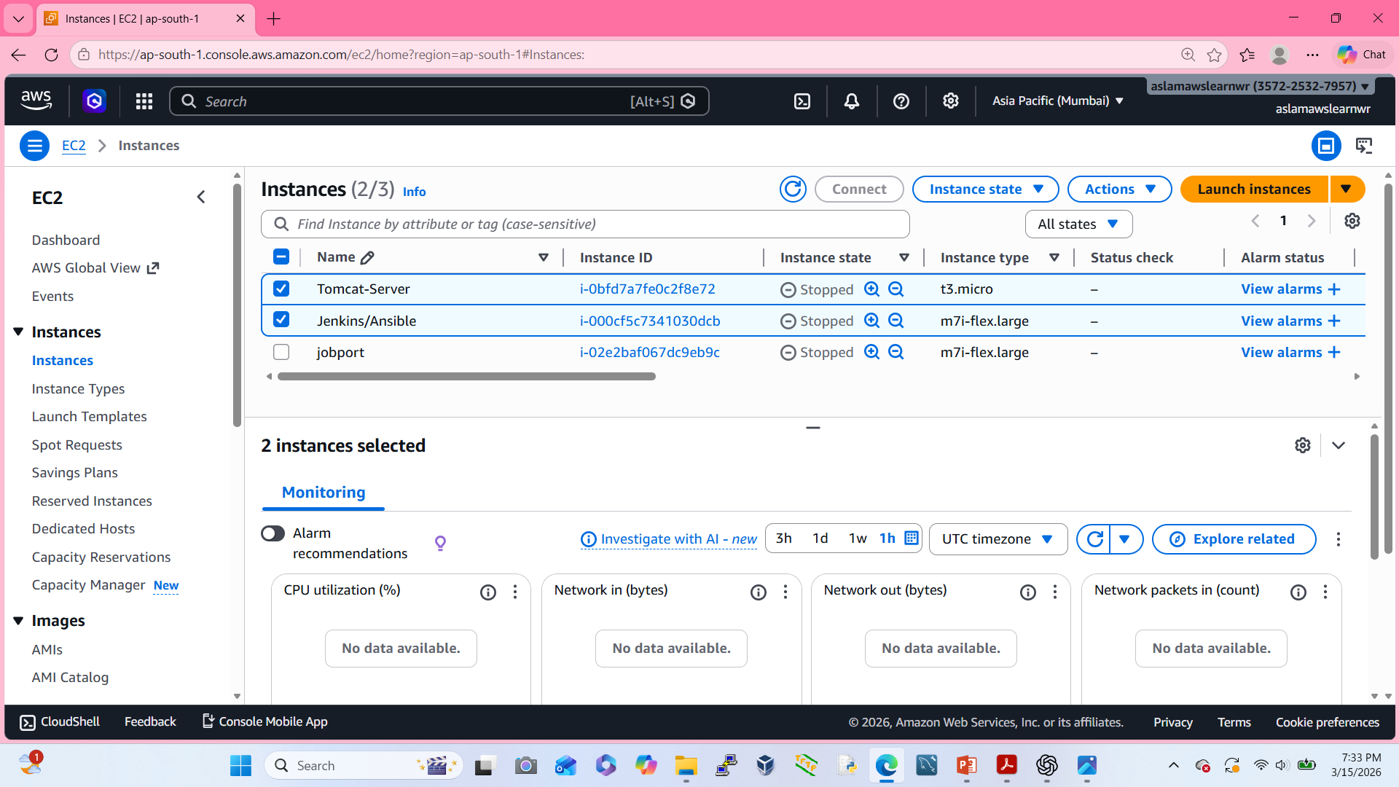
To create a EC2 Instance

Slide 3
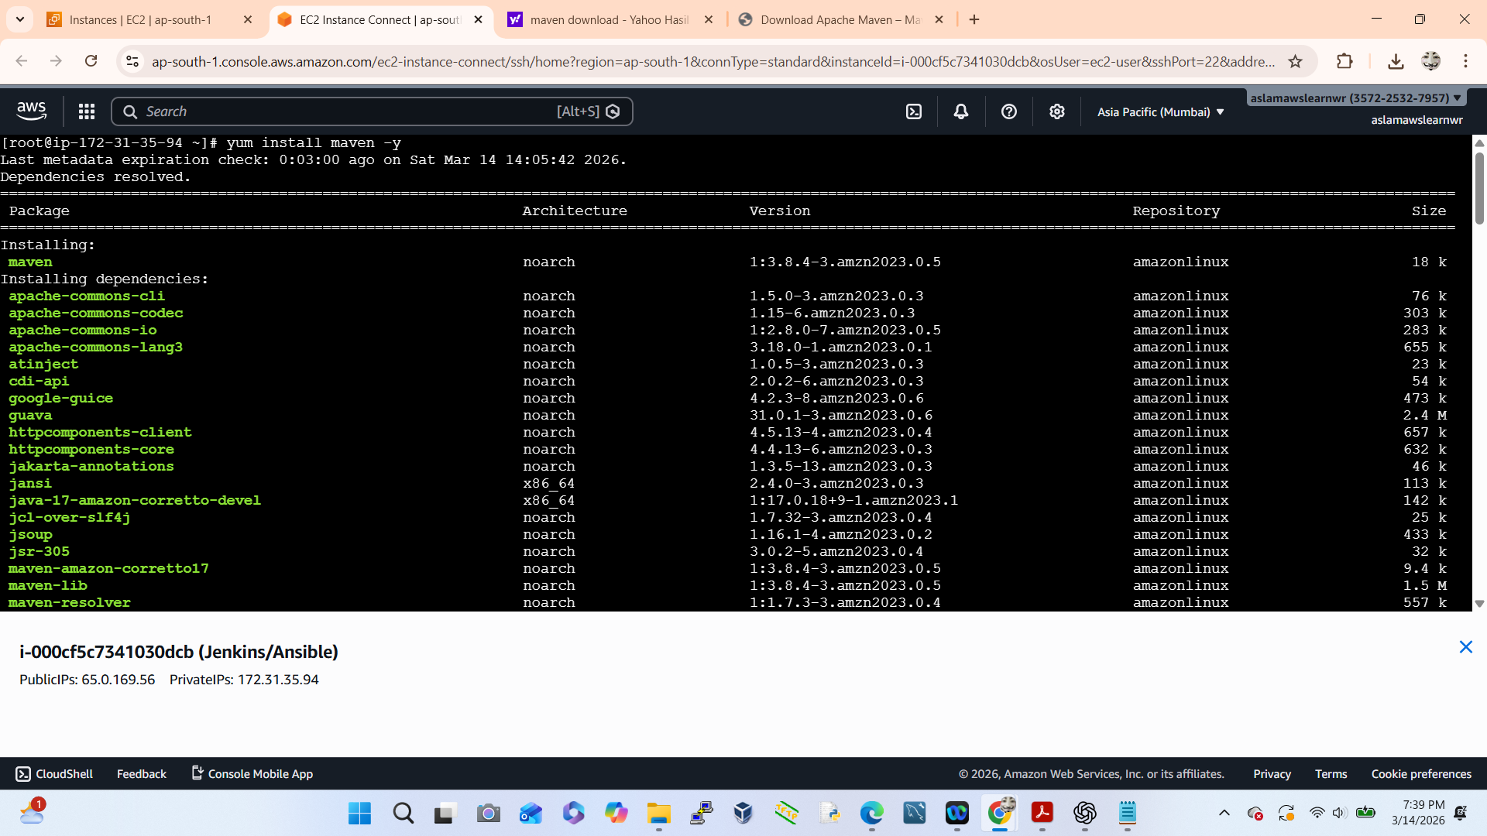
To install a Maven

Slide 4
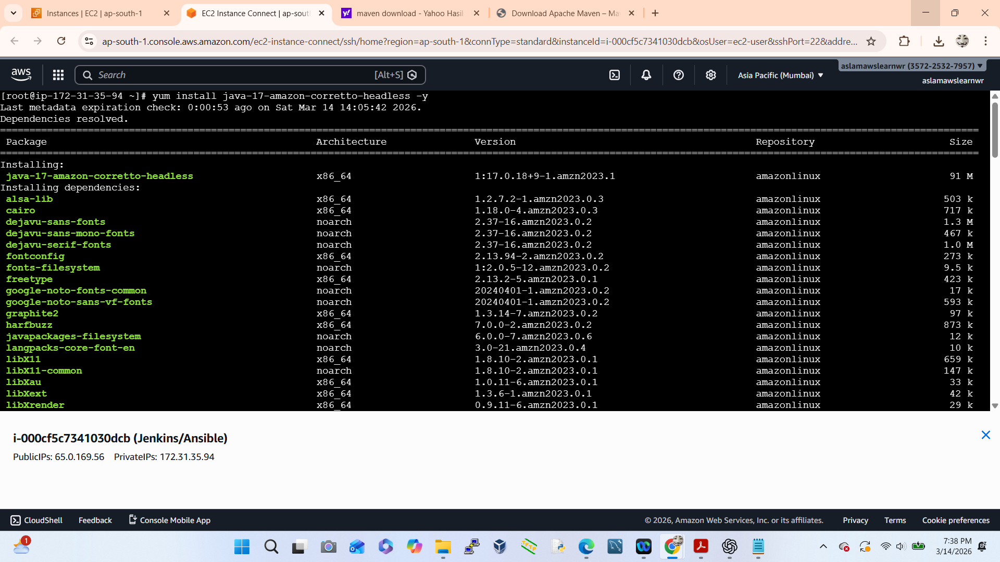
To install a Java

Slide 5
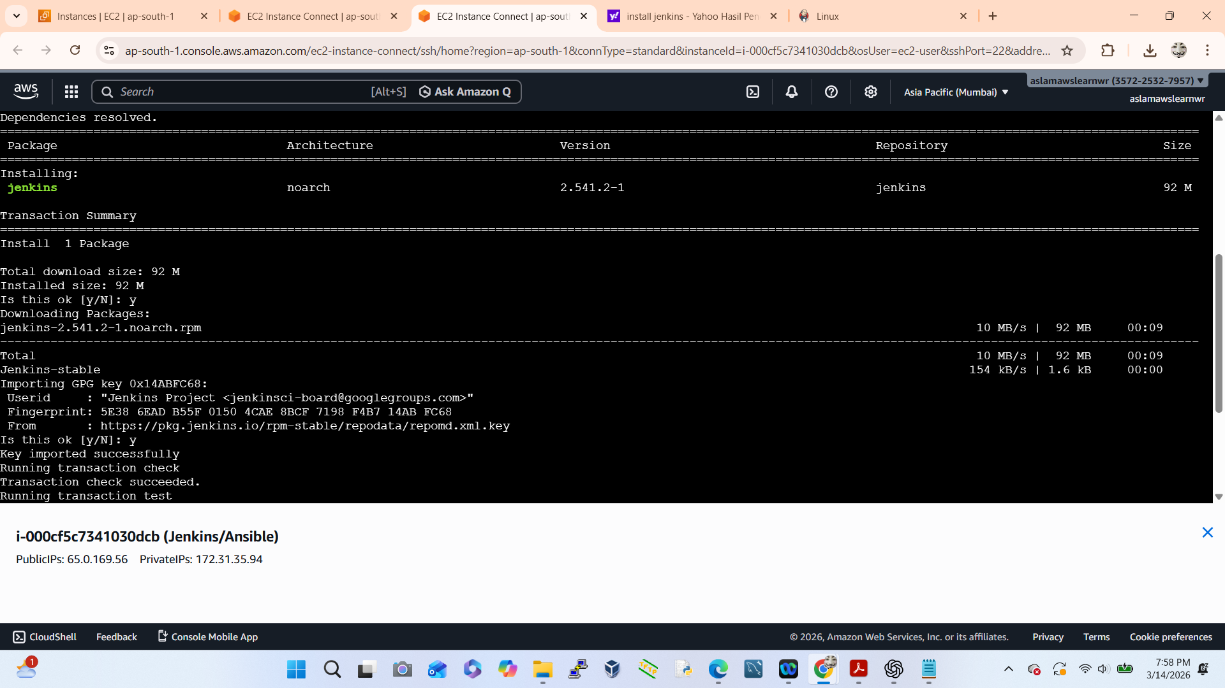
To install a Jenkins

Slide 6
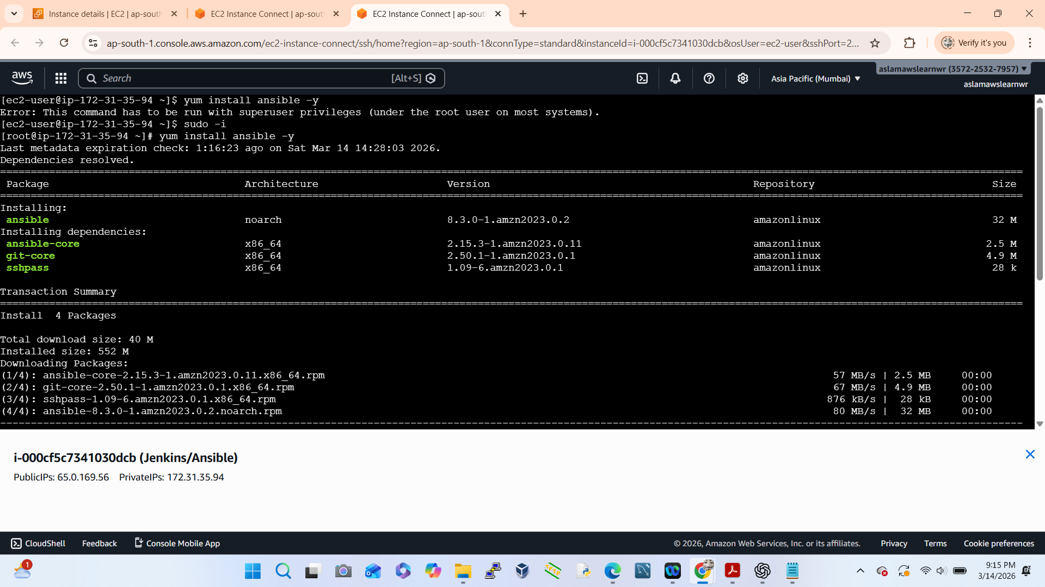
To install a Ansible

Slide 7
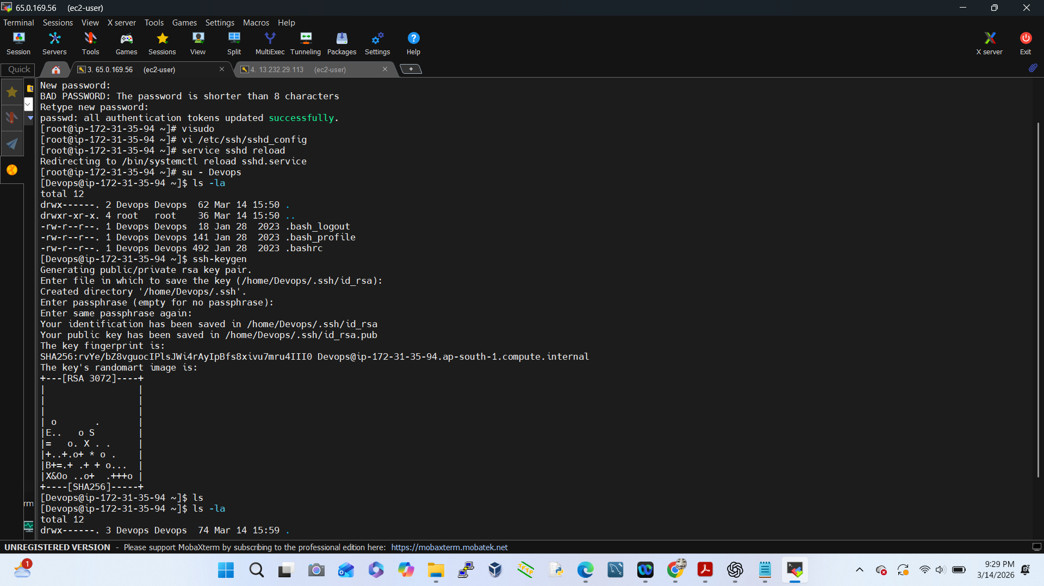
To create a Public Key

Slide 8
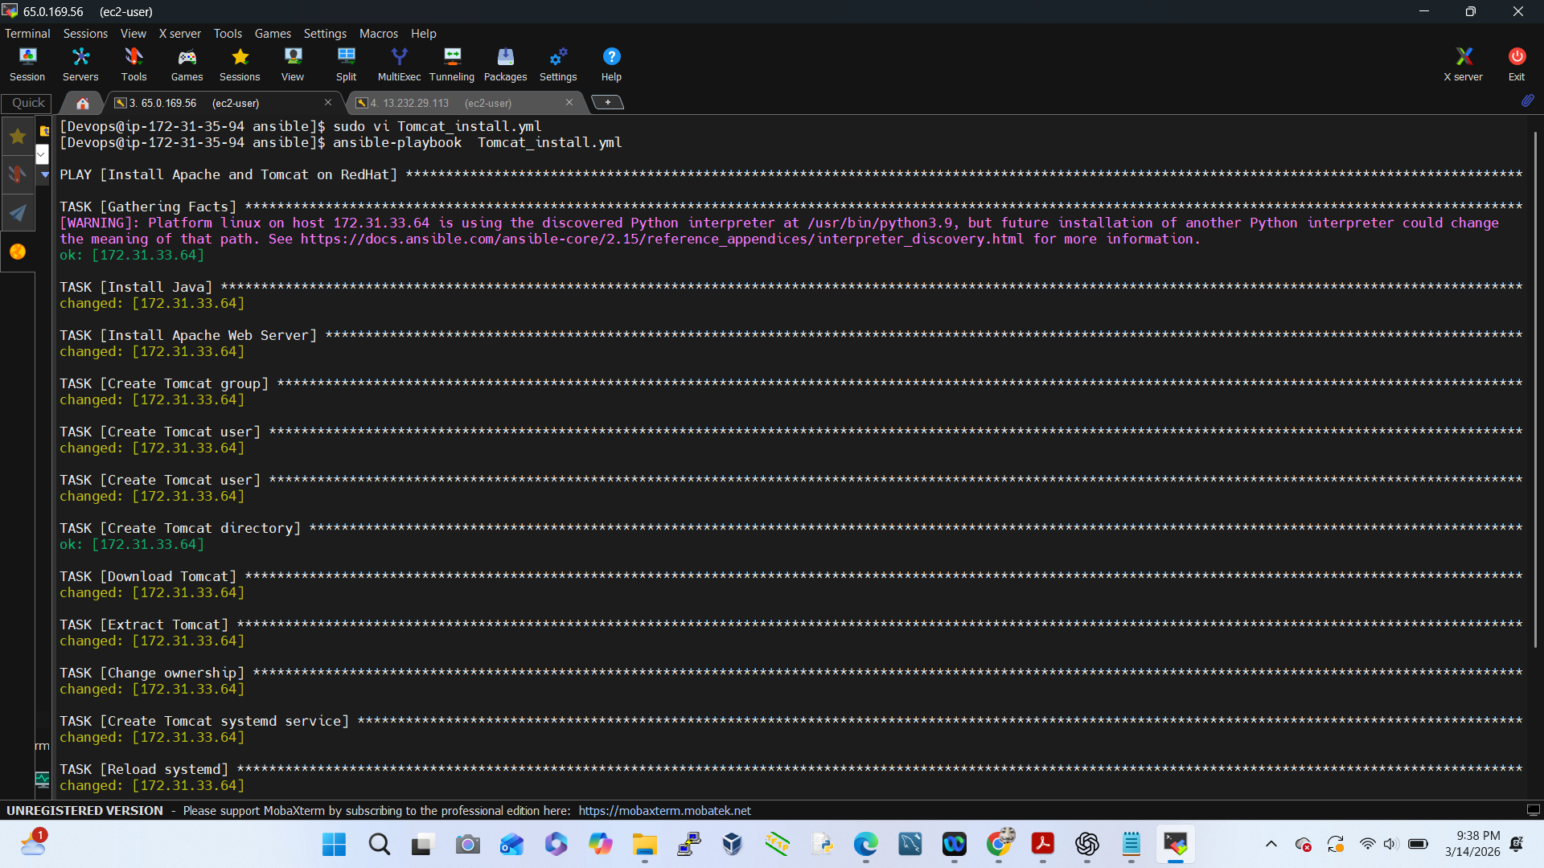
Installing Tomcat via Ansible Playbook

Slide 9
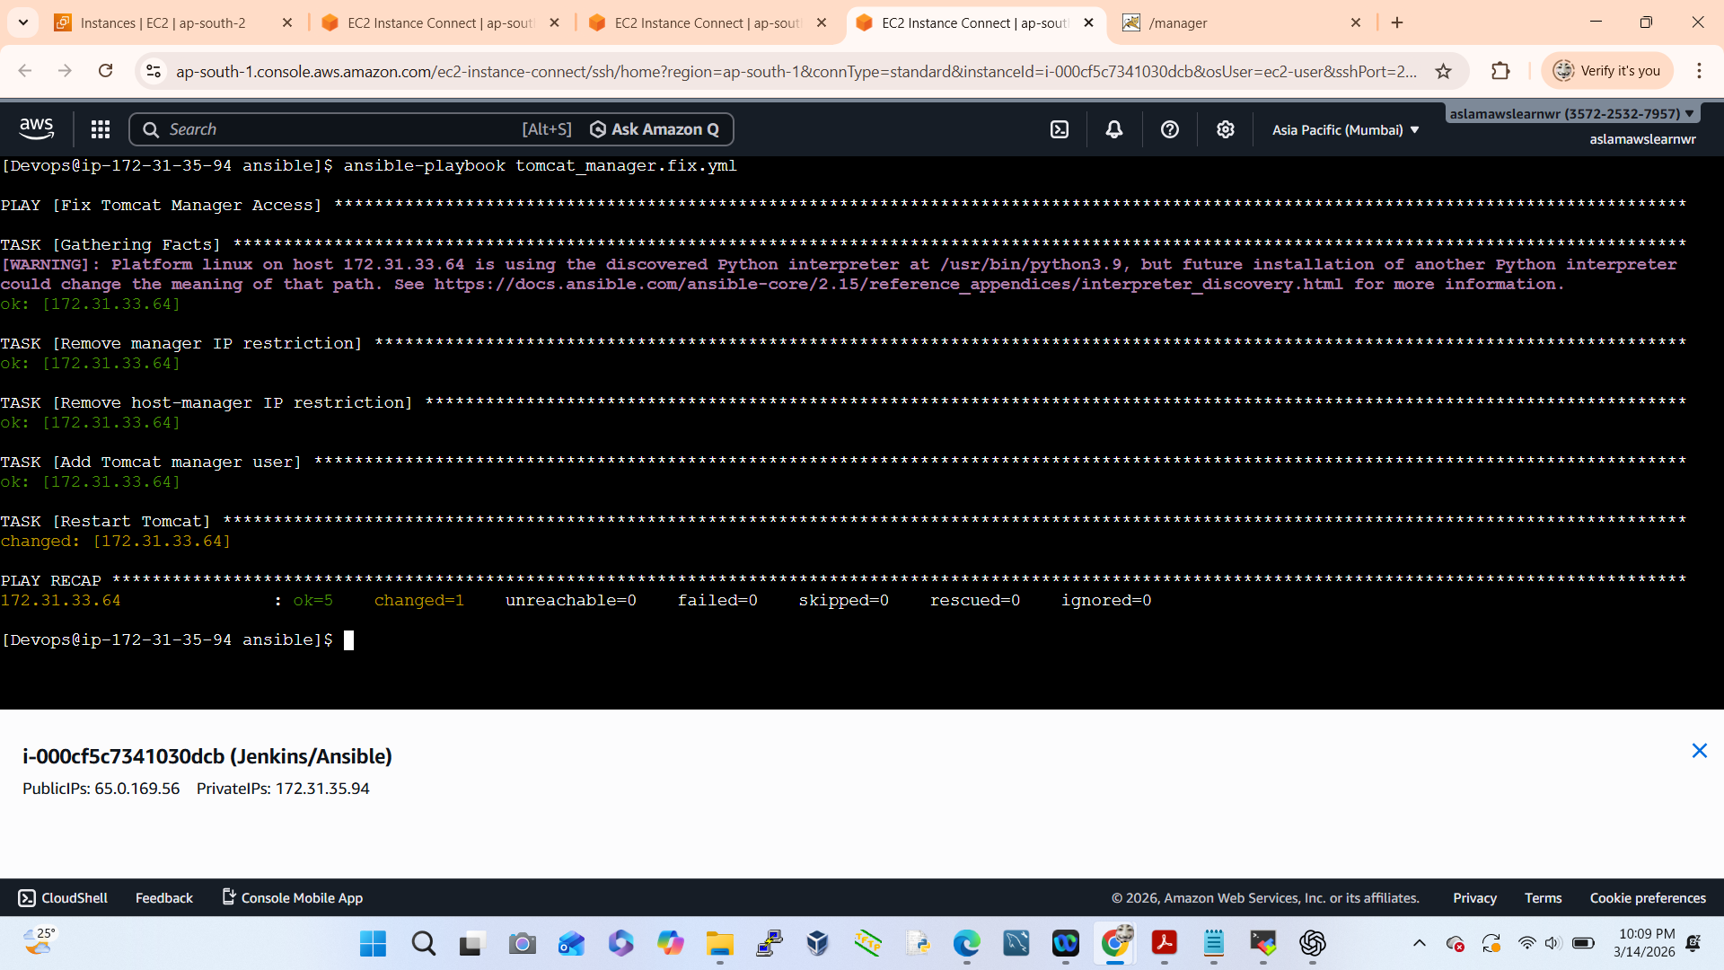
Fix Tomcat Manager Access (Ansible Playbook)

Slide 10
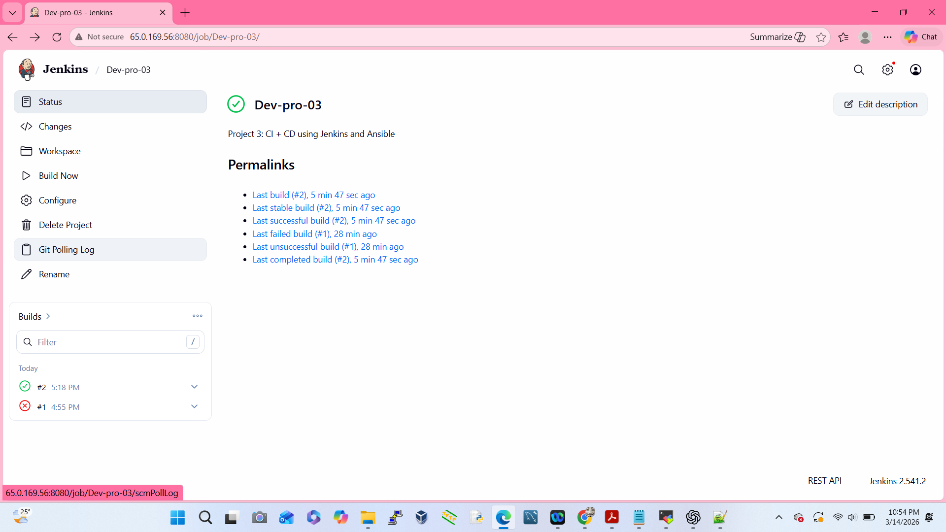
Run Jenkins Job

Slide 11
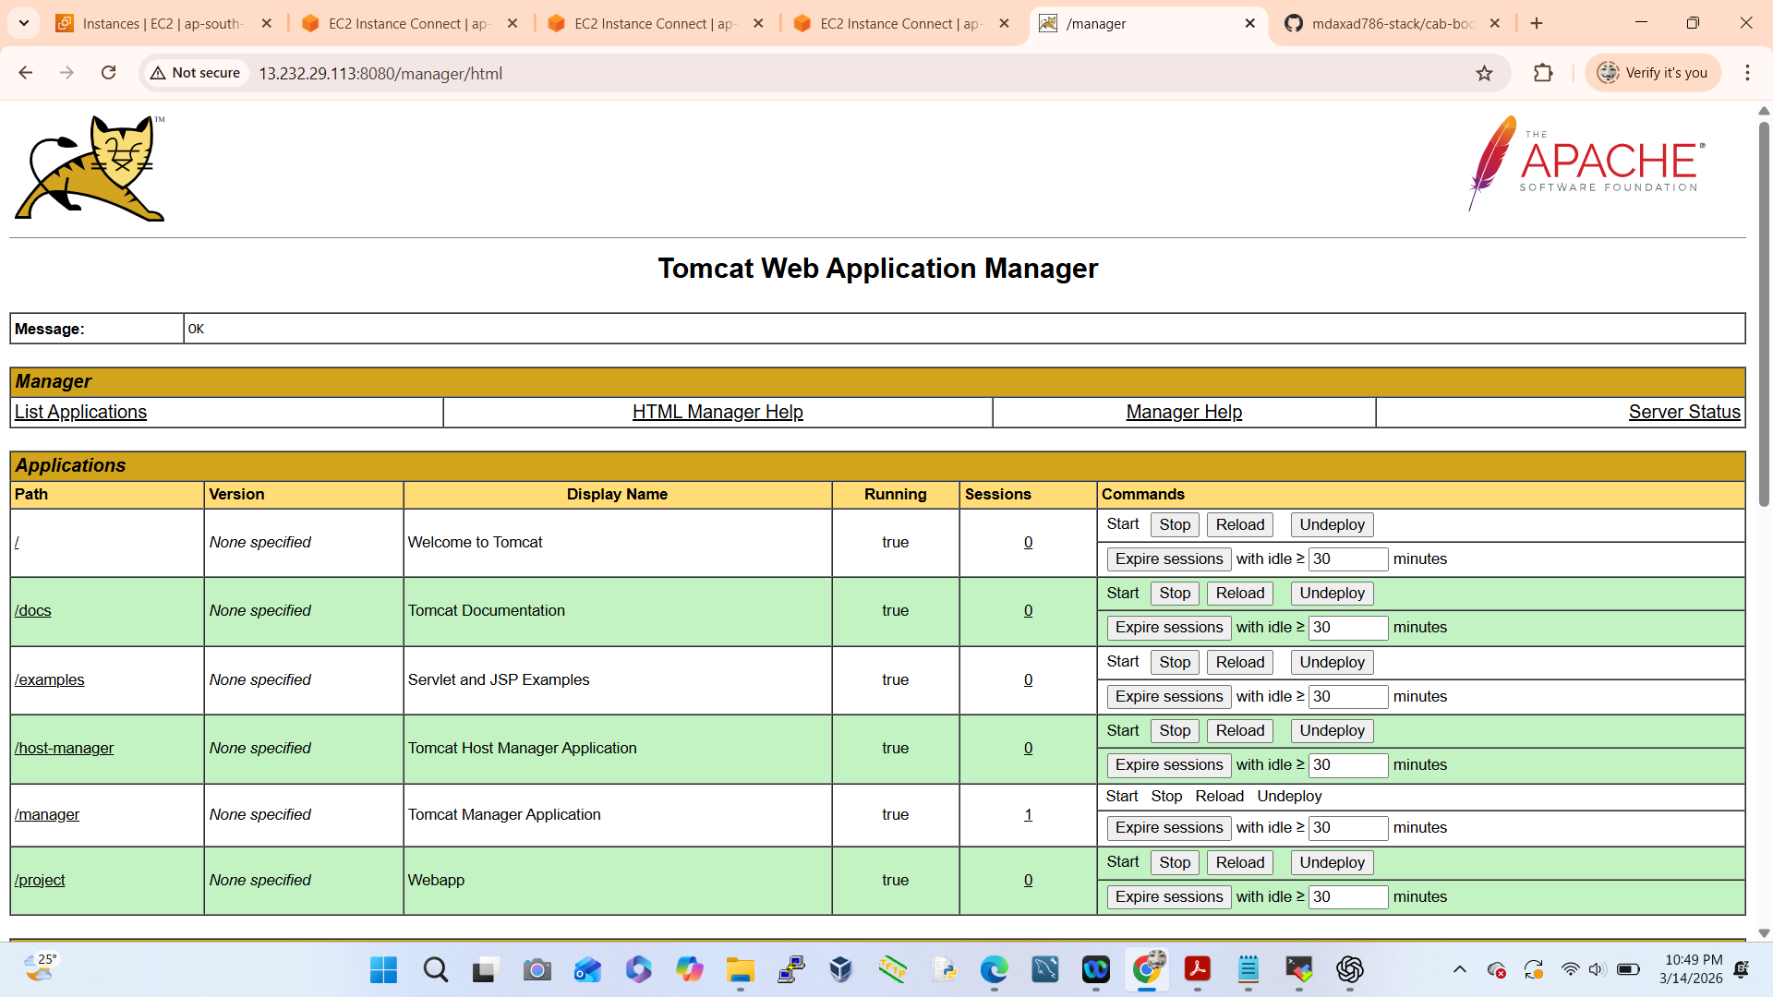
To Deploy Webapps in Tomcat Server

Slide 12
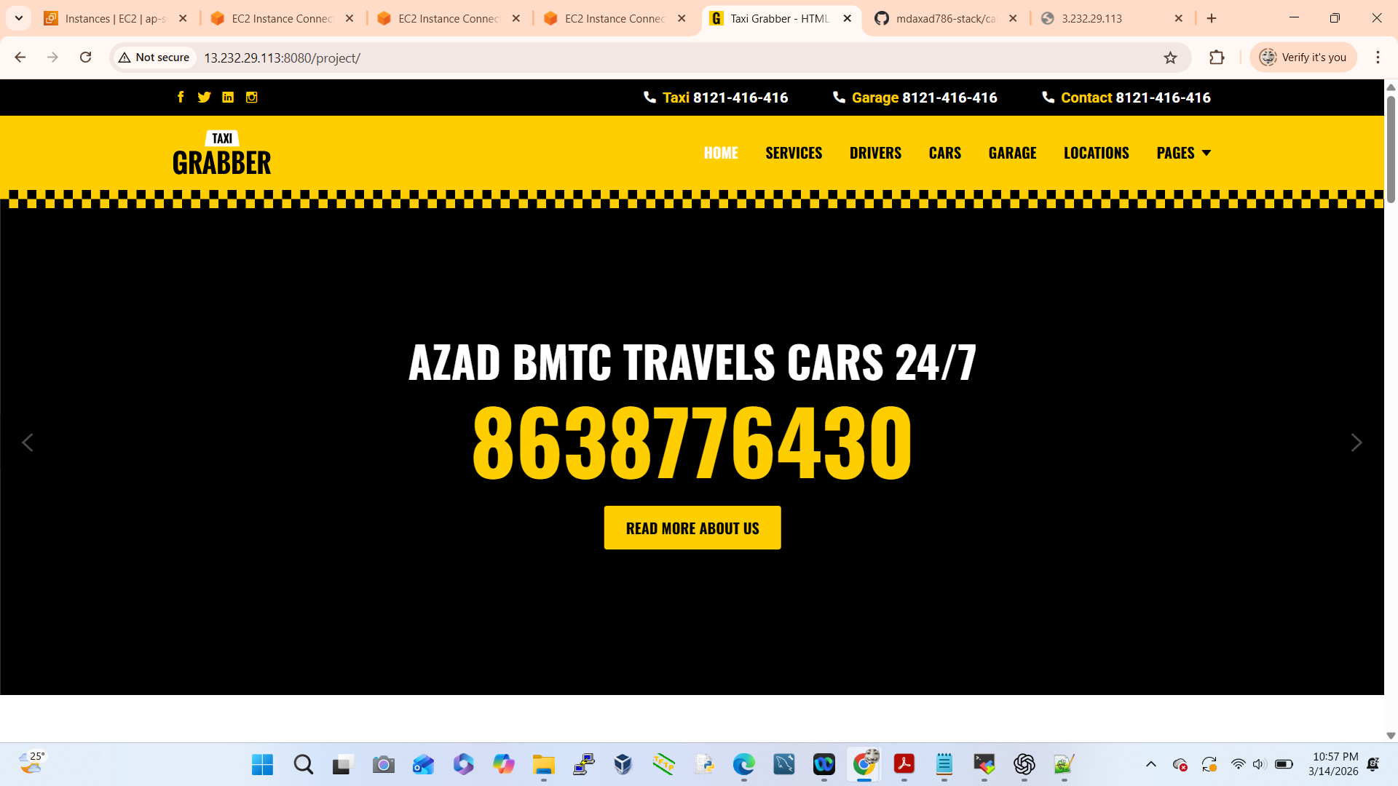
Verify Application

